Slide 1
SCR Masters Team
Informational Webinar
April 30, 2020
7:00P
By: Debbie Wells, President

Slide 2
SCR Goal for Masters Team
Create a pathway for SCR members who are age-group competitive to compete as a team at state, regional and possibly national competitions.
  Group support at races
  Shared training goals/partners
  Provide club support for these efforts
Develop recognition of Space Coast Runners club events to draw competitive runners from other parts of Florida and the SE region. And beyond!
  Increase value of SCR races for the charity recipients and club revenue
  Be RRCA Championship Race

Slide 3
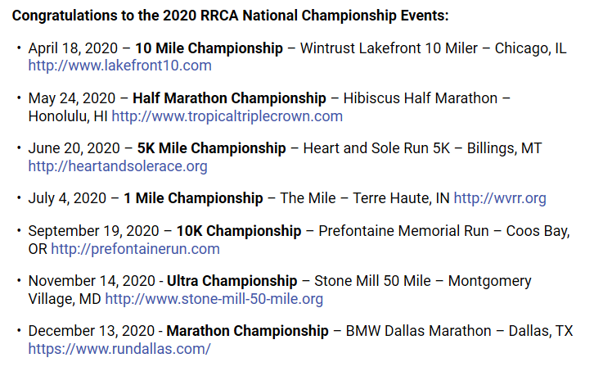

Possible Races
Florida and SE Regional RRCA Championship races
  Masters Age 40+
RRCA National Championship

Slide 4
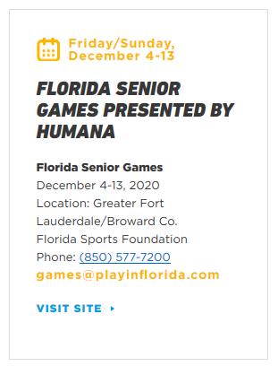
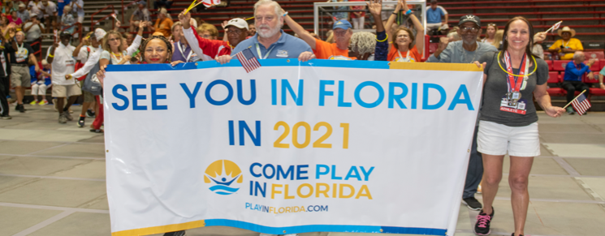
Possible Races
Florida Senior Games (Age 50+)
  5K Road – December
  5K/1500m Walk – December
  100m – 1500m, Relay – December
National Senior Games

Slide 5
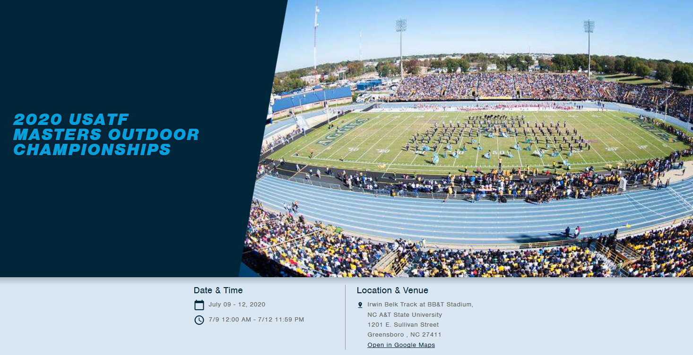

Possible Races
USATF Masters Outdoor Championships – July
USATF Masters Cross Country Championships - October

Slide 6
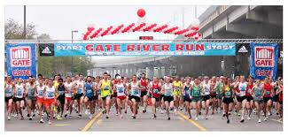
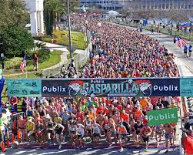
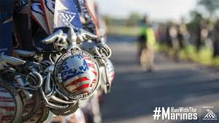
Possible Races
Gate River Run
Gasparilla Distance Classic
Marine Corps Marathon
Others?

Slide 7
Expectations
Be a Masters runner (RRCA Definition 40+ years old).
Be willing to train and represent SCR at state or regional races agreed upon by the team and SCR Board.
Wear your SCR singlet at all team races.
If race includes a team category, members will register as “Space Coast Runners Masters Team”.
Pay 50% of early registration (or difference if registering late) for chosen races (SCR will pay 50% of early registration costs).
Consent to use of image for marketing purposes.
Sign a Code of Conduct agreement.

Slide 8
Initial Application Process
Complete application May 22nd
  Personal information
  Brief overview of why you’d like to participate
  Best verified 5k and 10k time from the last two years
Data reviewed by Team Selection Committee May 22 – 29
Notification of selections May 30
Team Meeting Early June
  Select Captain(s)
  Select possible races/distances
  Discuss collaborative resources for training and travel coordination
Recruit additional SCR members to join for each race approx. 3 months prior
  Submit verified race distance times

Slide 9
Yes you can…
Be on another local team … races chosen would not be Brevard races and not conflict with local series races, where feasible
Join only for those races you are interested in participating
Join as part of the core team and have input into team decisions such as which races are planned for the team, which singlet is chosen, etc.

Slide 10
Questions?

